Slide 1


Well-being at the workplace
L.L.M. Wickremesinghe
Index Number: 229406T

Slide 2
Content
Introduction
Methodology
Demographics Visualization
Results and Discussion

Slide 3
Introduction
This research project aims to investigate a group of IT professionals’ job-related emotional perceptions and assess the level of well-being at your organization.
Job-related Affective Well-being Scale (JAWS) is used to assess the job-related emotional level and the level of well-being at your organization.

Slide 4




Methodology
60 IT company employees
Google form questionnaire
Analysis

Slide 5
Data Preparation
Answers were provided based on the below scale,
Never - 1
Rarely -2
Sometimes - 3
Quite often - 4
Extremely often - 5
Negative emotions were reversed only to compute the total score.

Slide 6
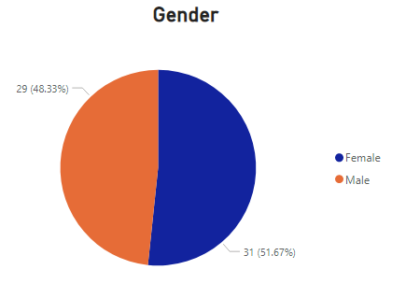
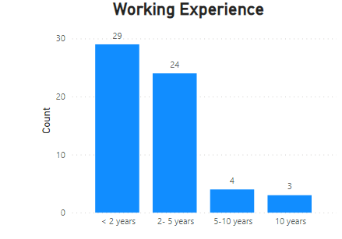
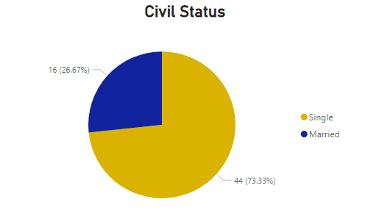
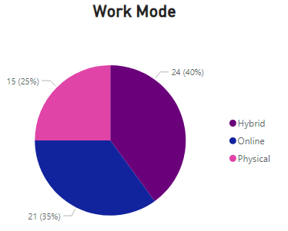
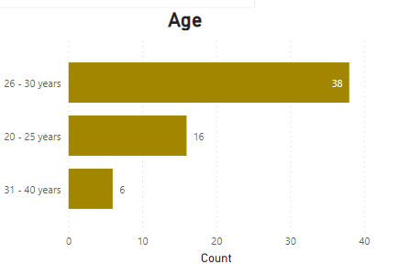
Demographics Visualization

Slide 7
Results and Discussion
Average JAWS value : 56.48

Slide 8
Results and Discussion
Average Negative emotion JAWS value :33.05
Average positive emotion JAWS value :23.41

